Slide 1



TEMPERATURE CONTROLLER FAN
DEPARTMENT OF ELECTRONICS AND COMMUNICATION ENGINEERING
ECB1204-ANALOG INTEGRATED CIRCUIT DESIGN
Presented by
Sri Vardhini T (2203811710622108)
Sudharshini R (2203811710622112)
Suwathi S (2203811710622114)
Under the Supervision of
Mrs . V.Gowri Assistant Professor
Electronic And Communication
f

Slide 2











PO/PSO MAPPING
Course Outcome s | Po1 | PO 2 | PO3 | PO4 | PO5 | PO6 | PO7 | PO8 | PO9 | PO1 0 | PO1 1 | PO1 2 | PS O1 | PS O2 | PS O3
Mapping
PO/PSO
Relevance to the Project (Automated Speed Breaker Activation and Deactivation on People analysis )
Mapped – The system integrates sensing, computation, and actuation, demonstrating the effective use of core engineering principles to solve a real-world traffic safety problem.
Mapped – The project analyzes the problem of unsafe pedestrian crossings and unnecessary slowdowns from static speed breakers.
Mapped – Designed a functional automated speed breaker system using sensors, Arduino, and a motor mechanism to solve pedestrian safety and traffic flow issues.
Mapped – Collected and analyzed These investigations helped refine
the design and ensure the system works reliably in real-world scenarios.
Mapped These tools help in coding, debugging, circuit analysis, and performance evaluation, showing the ability to apply modern engineering techniques to develop and optimize the solution..
Monday, December 1, 2025
PO1 – Engineering Knowledge
PO2 – Problem Analysis
PO3 – Design/Development of Solutions
PO4 – Conduct Investigations of Complex
Problems
PO5 – Engineering Tool Usage
3
EDP III

Slide 3



PO/PSO | Relevance to the Project (AI-Powered EMG-Controlled Assistive Glove)
PO6 – The Engineer and The World | Mapped – Developed a socially beneficial device aimed at rehabilitation and inclusion of differently-abled individuals.
PO7 – Ethics | Mapped – Ensured ethical handling of biosignals, user safety, and compliance with medical and engineering ethics.
PO8 – Individual and Team Work | Mapped – Achieved through effective teamwork in design, testing, and documentation phases of the project.
PO9 – Communication | Mapped – Communicated technical information clearly through reports, oral presentations, and documentation.
PO10 – Project Management and Finance | Mapped – Efficiently managed project components, budgeting, and scheduling during the design and testing phases.
PO11 – Life-Long Learning | Mapped – Encouraged continuous learning of AI, embedded systems, and biosignal processing to adapt to emerging technologies.
PO12 – Environment and Sustainability | Not Mapped – The project does not directly address environmental or sustainable material considerations but promotes inclusive health innovation.
PSO1 – Applied Electronics | Mapped – Designed and integrated EMG signal acquisition circuits, filters, and actuators for assistive control.
PSO2 – Communication Systems | Mapped – Implemented Bluetooth communication for data transmission and remote therapy interface.
PSO3 – Embedded Systems and VLSI 4 | Mapped – Developed a microcontroller-based embedded system integrating sensors, machine learning, and real-time actuation.
EDP III
Monday, December 1, 2025

Slide 4
OUTLINE
PROBLEM STATEMENT
ABSTRACT
INTRODUCTION
OBJECTIVES AND GOALS
NOVELTY OF THE PROJECT
LITERATURE SURVEY
EXISTING METHOD
ANALYSIS AND EXPLANATION OF THE IDENTIFIED PROBLEM
PROPOSED METHOD
RESULTS & OUTPUTS
ADVANTAGES AND APPLICATIONS
TIME PLAN OF PROJECT
5
REFERENCES
Monday, December 1, 2025
EDP III

Slide 5
ABSTRACT
This project presents an automatic temperature-controlled fan system designed to regulate fan speed based on room temperature. A temperature sensor continuously monitors the surrounding environment and sends the data to an Arduino microcontroller. Based on the sensed temperature, the controller adjusts the fan speed using pulse width modulation (PWM), increasing the speed at higher temperatures and reducing it when the temperature decreases. This system eliminates the need for manual fan control, improves user comfort, and helps conserve electrical energy. The project demonstrates a simple, cost-effective, and efficient approach to automation that can be applied in homes, offices, and industrial environments.
EDP III
Monday, December 1, 2025

Slide 6
OBJECTIVE OF THE PROJECT
To design an automatic fan speed control system based on room temperature.
To sense real-time temperature using a temperature sensor.
To control the fan speed automatically without manual adjustment.
To increase fan speed when the temperature rises and decrease it when the temperature falls.
To reduce energy consumption through efficient fan operation.
To demonstrate the application of microcontrollers in home automation systems.
To provide a cost-effective and user-friendly solution for maintaining a comfortable indoor environment.
EDP III
Monday, December 1, 2025

Slide 7
NOVELTY OF THE PROJECT
The project introduces an automatic fan speed control system that operates purely based on real-time temperature variations.
It eliminates the need for manual speed regulators, making the system fully autonomous.
The fan speed is controlled using PWM technology, ensuring smooth and efficient operation.
The design focuses on energy optimization by running the fan only at the required speed.
The system uses a simple and low-cost hardware setup, making it easy to implement and scalable for different environments.
.
EDP III
8
Monday ,December 1, 2025

Slide 8
LITERATURE SURVEY
Year of publication | Title & Author | Technology Implemented | Gaps | Limitations
2017 | Automatic Temperature Controlled Fan System –S.K. Patil , R.M. Deshmukh | LM35 temperature sensor with microcontroller-based PWM control. | No provision for remote monitoring or advanced control algorithms | Limited temperature accuracy and lack of scalability
2018 | Smart Fann Conrtrol Usingg Arduino– A.Kumar , P.Singhh | Arduino Uno with temperature sensor and DC fan speed control | Focuses only on fixed temperature ranges | Manual threshold setting and limited adaptability
2019 | Energgy Efficient Fan Speed Controller – R. Sharma, M. Verma | PWM-based fan control using microcontroller | Does not consider environmental factors like humidity | Efficiency depends heavily on sensor calibration
2020 | Temperature based Home Appliance Automation – K. Park. J.Lee. | Embedded system with temperature sensing and automation | System complexity is high for simple applications | High cost and increased hardware complexity
2021 | Low-Cost Automated Plant Watering System – M.R.Naik, S. Joshi | Embedded controller with analog temperature sensor | No data visualization or feedback mechanism | Limited user interaction and basic control logic
9
EDP III
Monday, December 1, 2025

Slide 9
EXISTING METHOD
In the existing system, fan speed is controlled manually using a mechanical regulator or switch.
Users need to adjust the fan speed frequently according to changes in room temperature.
The fan continues to run at the same speed even when cooling is not required, leading to energy wastage.
There is no automatic temperature sensing or intelligent control mechanism involved.
Human intervention is required at all times to maintain comfort levels.
EDP III
Monday, December 1, 2025

Slide 10
ANALYSIS AND EXPLANATION OF THE IDENTIFIED PROBLEM
Conventional fan systems rely on manual speed control, which does not respond automatically to temperature changes.
Users often forget to adjust the fan speed, causing discomfort during sudden temperature variations.
Continuous operation at higher speeds results in unnecessary power consumption and reduced energy efficiency.
Manual regulators provide fixed speed levels, lacking precise control based on real-time conditions.
The absence of automation increases human effort and reduces the overall effectiveness of temperature regulation.
EDP III
Monday, December 1, 2025

Slide 11
PROPOSED METHOD
The proposed system uses a temperature sensor to continuously monitor the room temperature.
An Arduino microcontroller processes the sensor data in real time.
The fan speed is automatically controlled using PWM (Pulse Width Modulation) based on temperature changes.
As the temperature increases, the fan speed increases automatically, and it decreases when the temperature drops.
The system operates without manual intervention, improving user comfort and energy efficiency.
EDP III
Monday, December 1, 2025

Slide 12
METHODOLOGY
sing zone
The temperature sensor is placed in the room to continuously sense ambient temperature.
The sensed temperature data is sent to the Arduino microcontroller for processing.
The microcontroller compares the temperature with predefined threshold values.
Based on the comparison, an appropriate PWM signal is generated.
The PWM signal controls the fan speed through a driver circuit/transistor.
The fan speed increases or decreases automatically according to temperature changes.
14
Monday, December 1, 2025
EDP III

Slide 13
HARDWARE AND SOFTWARE
COMPONENTS
s.no | Hardware Components | Quantity
1. | Bread Board | 1
2. | Arduino UNO | 1
3. | 12V DC Fan | 1
4. | L298N Motor driver module | 1
5. | Jumper cable | As required
6. | 12V Adapter | 1
7. | DHT Sensor | 1
15
REVIEW 1
Day, Month-date , 2025
EDP III
Monday, December 1, 2025

Slide 14
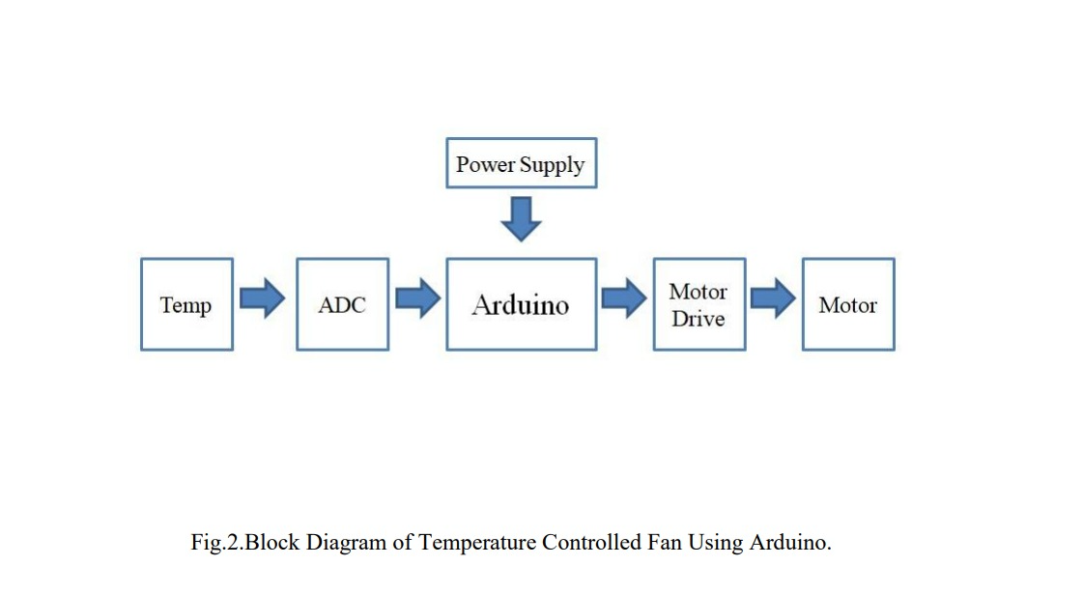
BLOCK DIAGRAM
16
EDP III
Monday, December 14, 2025

Slide 15
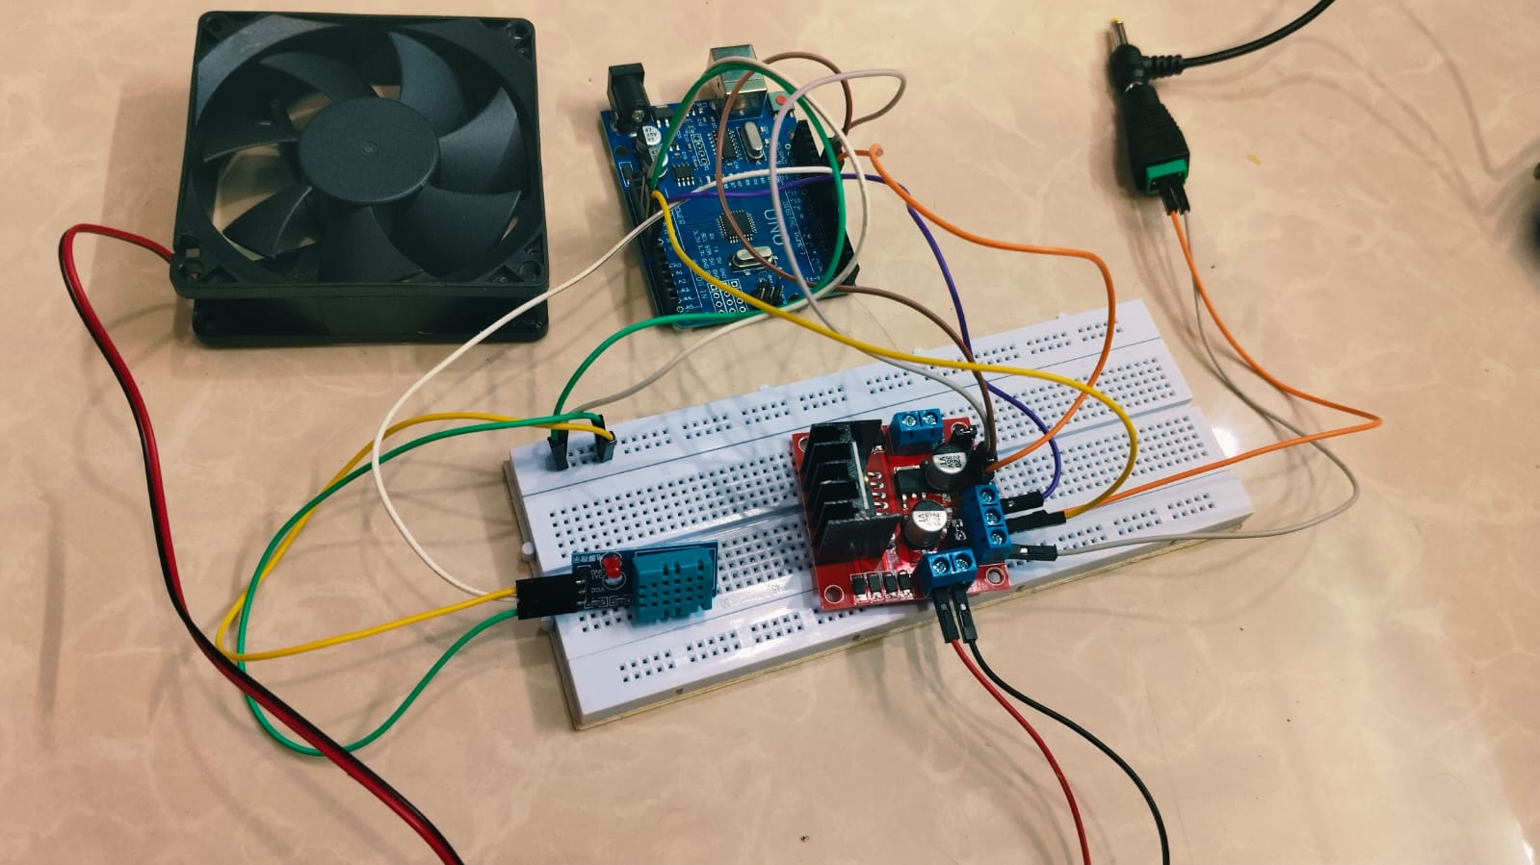
HARDWARE IMPLEMENTATION
EDP III
Monday, December 14, 2025

Slide 16
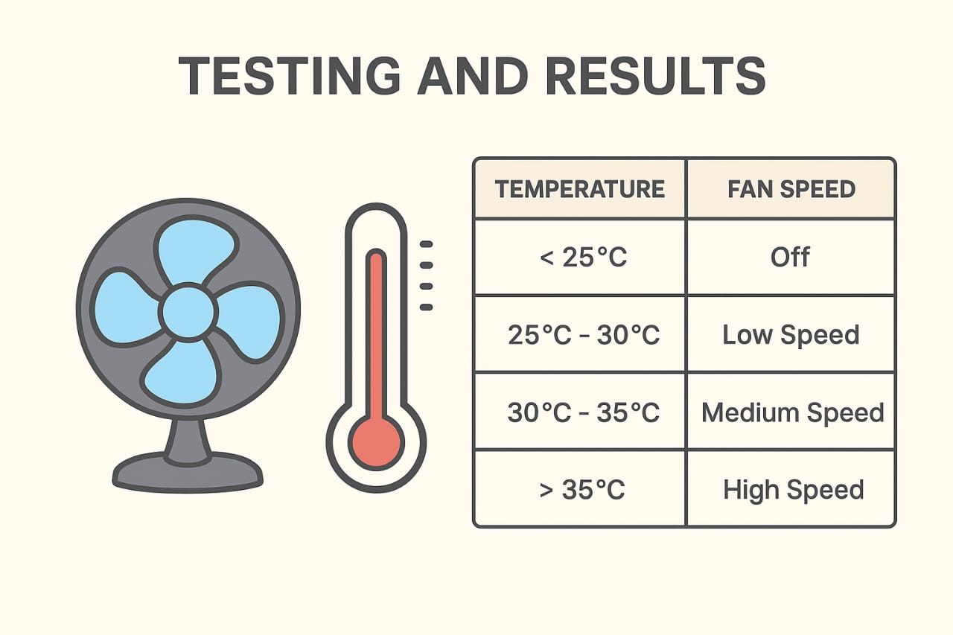
EDP III
Monday, December 14, 2025

Slide 17
APPLICATION & ADVANTAGES
Advantages
Automatically adjusts fan speed based on room temperature
Reduces power consumption and saves electricity
Eliminates the need for manual fan control
Provides consistent and comfortable cooling
Simple design with low implementation cost
Reliable and accurate temperature response
Easy to upgrade with wireless or sensor enhancements
Applications
Smart home and home automation systems
Offices and commercial buildings
Computer server rooms and data centers
Industrial cooling and ventilation systems
Greenhouses and agricultural environments
Laboratories and research centers
Educational and training projects
Energy-efficient HVAC support systems
19
EDP III
Monday, December 14, 2025

Slide 18
FUTURE SCOPE
Integration with Smart Home Systems – The fan can be connected to IoT platforms for remote control via smartphone or voice assistants.
Humidity and Air Quality Control – Future versions can include sensors for humidity, smoke, or dust to optimize indoor comfort and air quality.
Energy Efficiency Enhancements – Fan speed can be adjusted dynamically to save electricity while maintaining comfort.
AC Fan Compatibility – The system can be upgraded to control standard AC fans using relays or triac circuits.
20
EDP III
Monday, December 1, 2025

Slide 19
CONCLUSION
The temperature-controlled fan project successfully demonstrates an automatic and intelligent approach to indoor cooling, where the fan speed adjusts according to the ambient temperature without any manual intervention. This system not only enhances comfort but also improves energy efficiency by running the fan only at the required speed. By combining a temperature sensor with a microcontroller and motor control, the project highlights the practical application of embedded systems and automation in everyday life. The design is simple, cost-effective, and scalable, making it suitable for home, office, and industrial environments. Future enhancements could further integrate smart features and IoT connectivity, providing a modern solution for energy-conscious and convenient temperature management.
21
EDP III
Monday, December 1, 2025

Slide 20
REFERENCES
1. Bhattacharya, S. K. (2019). Basic Electrical and Electronics Engineering. Pearson Education.
Useful for understanding sensors, resistive networks, and basic electronic components used in
analog control systems.
2. Boylestad, R. L., & Nashelsky, L. (2022). Electronic Devices and Circuit Theory (12th
Edition). Pearson Education.
Covers detailed explanations of transistor switching, op-amp comparator circuits, and analog
signal conditioning.
3. Floyd, T. L. (2021). Principles of Electric Circuits: Conventional Current Version (11th
Edition). Pearson Education.
Provides foundational concepts on power supplies, transistor switching, and protection circuits
like flyback diodes.
4. Gayakwad, R. A. (2018). Op-Amps and Linear Integrated Circuits (5th Edition). Prentice Hall
of India.
Key reference for understanding op-amp comparator operation, calibration, and reference
voltage design.
5. Gupta, B. R., & Singhal, V. (2018). Fundamentals of Electronics. S. Chand & Company Ltd.
Provides insights into temperature sensing elements and their characteristics in analog
applications.
23
EDP III
Monday, December 1, 2025

Slide 21
THANK YOU
24
EDP III
Monday, December 1, 2025

